Slide 1
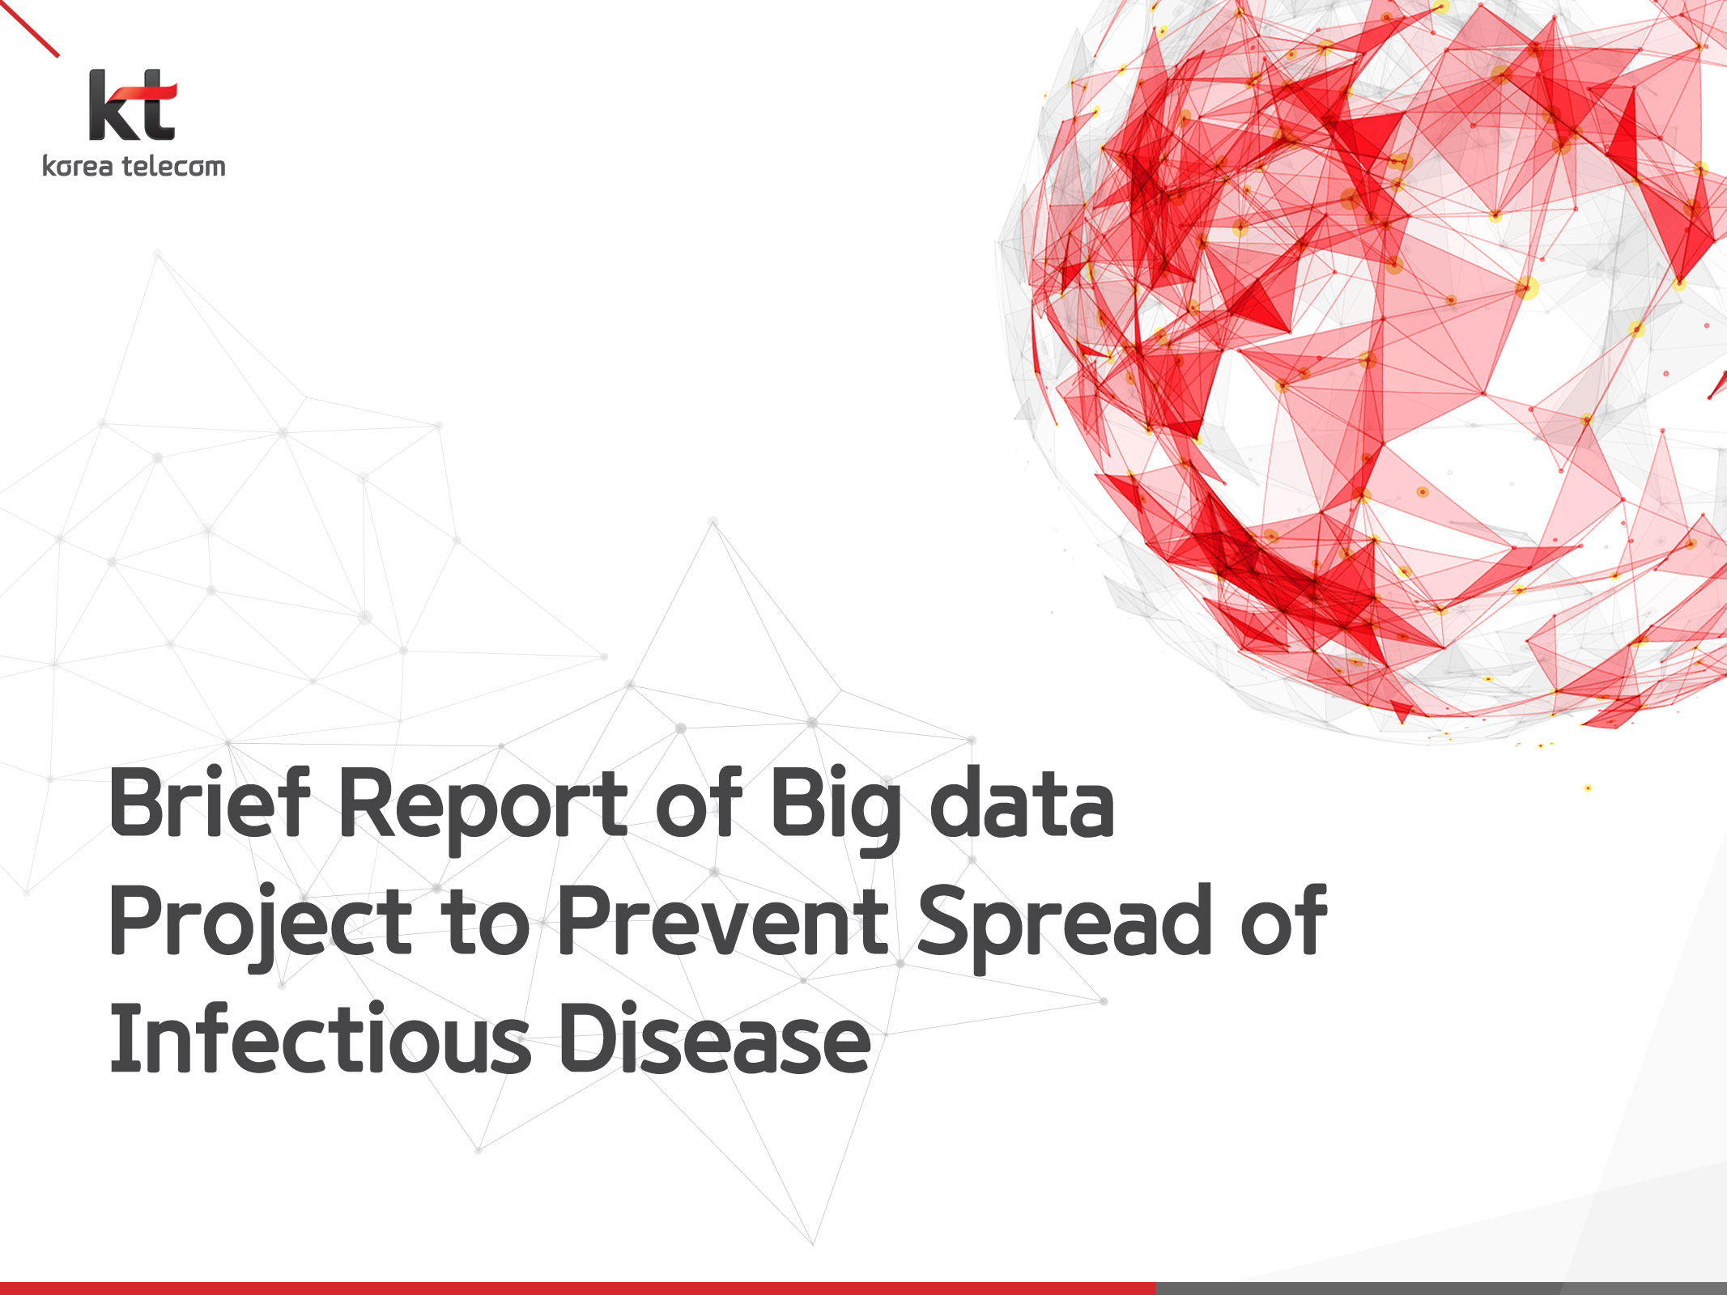

The Pursuit of Happiness Factors
: What Factors Correlate More with Happiness?
Paul Dean, Soobin Hwang, Mark Gatongay, Seunghwa Jun
UofTSTG201905DATA3 ｜ July 16, 2019

Slide 2

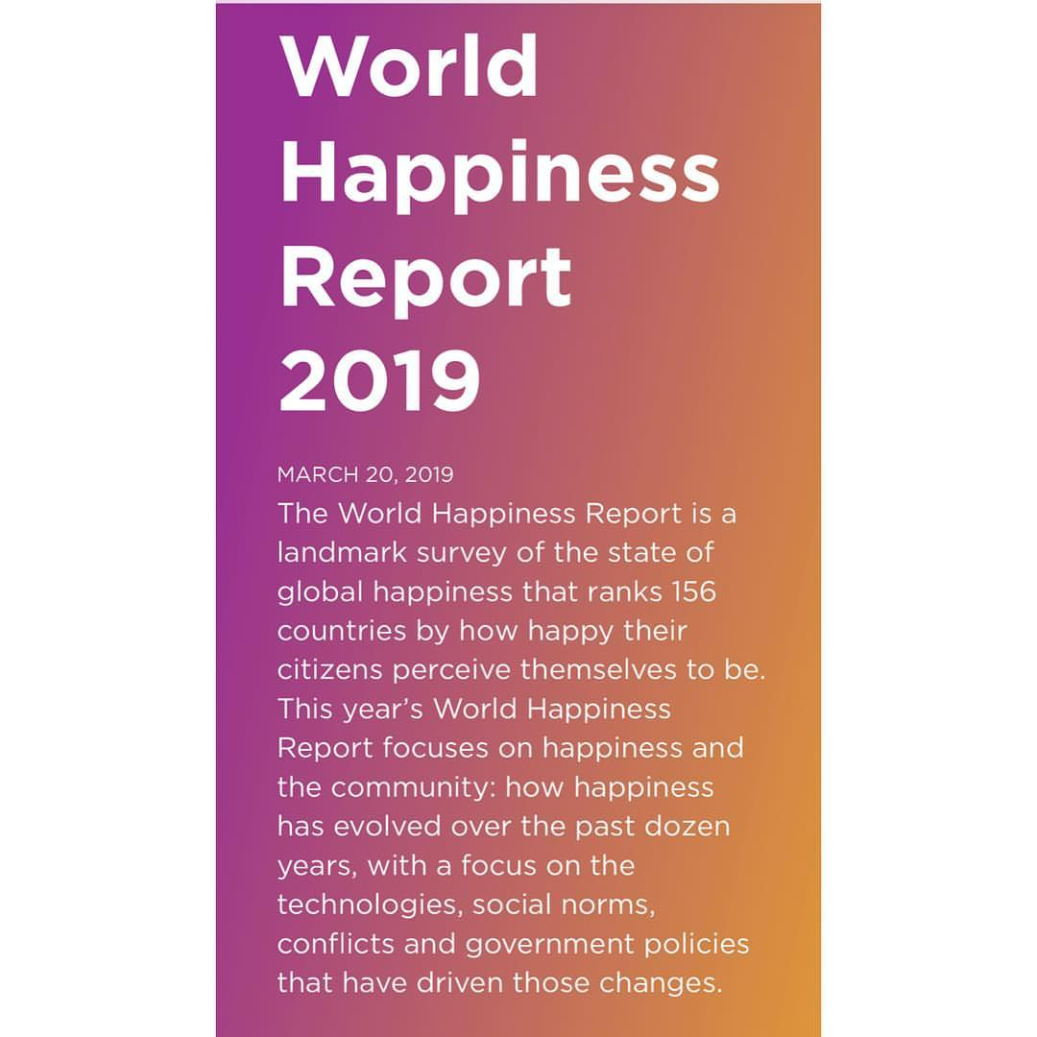
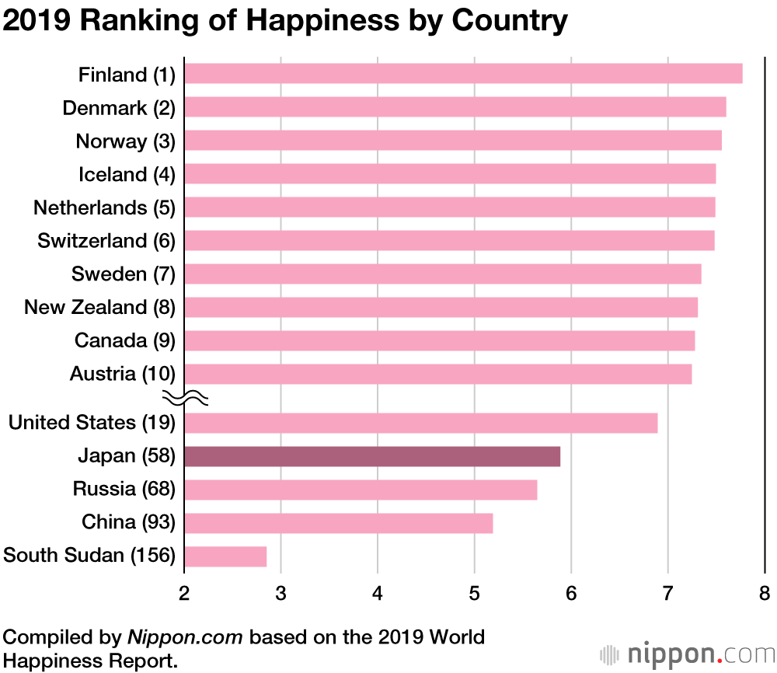
Motivation
It all started with one report,
“The World Happiness Report 2019(Gallup).”
Hmm.. Why some countries are happy and others are miserable? What factors correlate more with happiness?
Wait, it’s great for practicing what we’ve learned so far!

Slide 3
Introduction
‘The World Happiness Report’ is a landmark survey of the state of global happiness that ranks 156 countries by how happy their citizens perceive themselves to be.
So, we tried to find important factors that are strongly
correlated to the level of happiness among11 indices:
1) GDP per capita, 2) Healthy life expectancy,
3) Social Support, 4) Freedom, 5) Generosity,
6) Trust in government, 7) Unemployment Rate,
8) Birth Rate, 9) Obesity Rate, 10) Population Density,
and 11) Weather
“11 indices? Are you kidding?”
“ Yeah.. They are Eleven.. And we did it!”

Slide 4
Data
“11 indices mean… Bunch of Data!!”
Many websites were searched through….
: Kaggle, WorldHappiness.report, CIA, Data.World,
WorldBank, OECD, WorldEconomicForum, Gallup, etc
Three APIs utilized…
: World Bank API, OpenWeatherMap API, Google Maps
As a result,
Roughly 30 csv files were downloaded and created…!

Slide 5
Data Clean Up & Exploration
Data Clean Up & Format
: Pandas, Jupyter Notebook, Excel
Data Analysis
: Matplotlib, SciPy, Numpy, Panda, Pandas.plotting
Visualization
: Line Graph, Bar Graph, Pie Graph, Box Plot,
Scatter Plot, Scatter Matrix, Geographical Heatmap

Slide 6
Questions (contents)
Ι
What are the characteristics of
‘Happy’ vs. ‘Miserable’ Countries?
Ⅱ
What ‘Factors’ Correlate More
With the Level of Happiness?
Ⅲ
Why and How are the ‘Top Two Factors’
Strongly Related to Happiness?

Slide 7
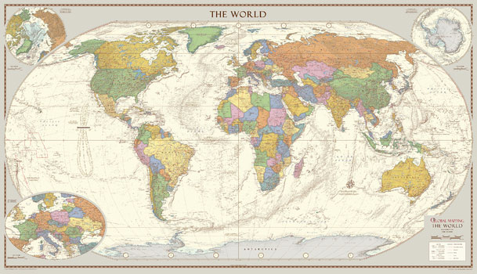
I. What are the Characteristics of
‘Happy’ vs. ‘Miserable’ Countries?

Slide 8
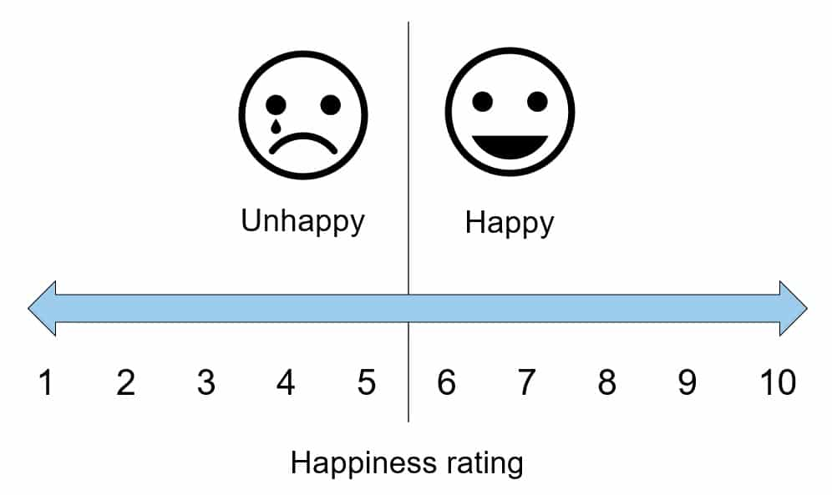
How ‘Happy’ Are You??
Rate your level of happiness from 1 to 10

Slide 9
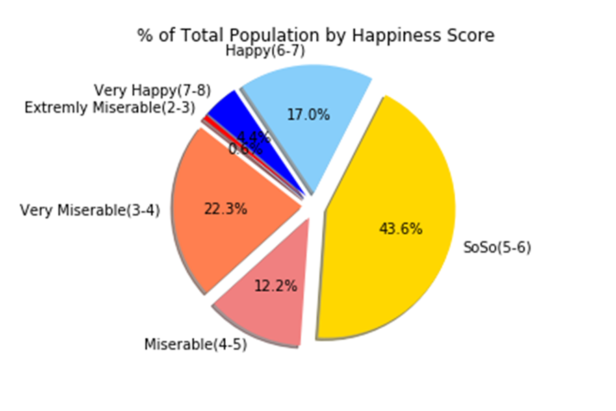
What about the World?
Where do you belong?
% of Total Population by Happiness Score
Data : Gallup(2018) ‘World Happiness Report’ / CIA ‘World Population’

Slide 10
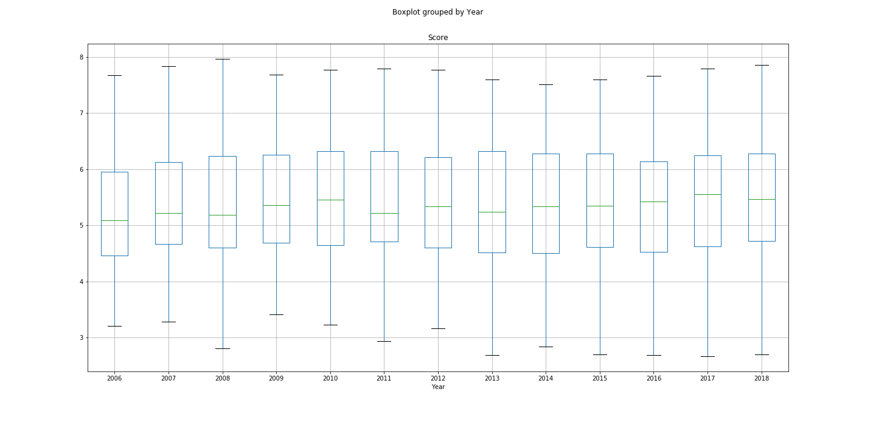
Global Happiness Trend
The overall happiness level hasn’t changed a lot…
Happiness Scores Grouped by Year (2006 ~ 2018)
Data : Gallup(2006~2018) ‘World Happiness Report’

Slide 11
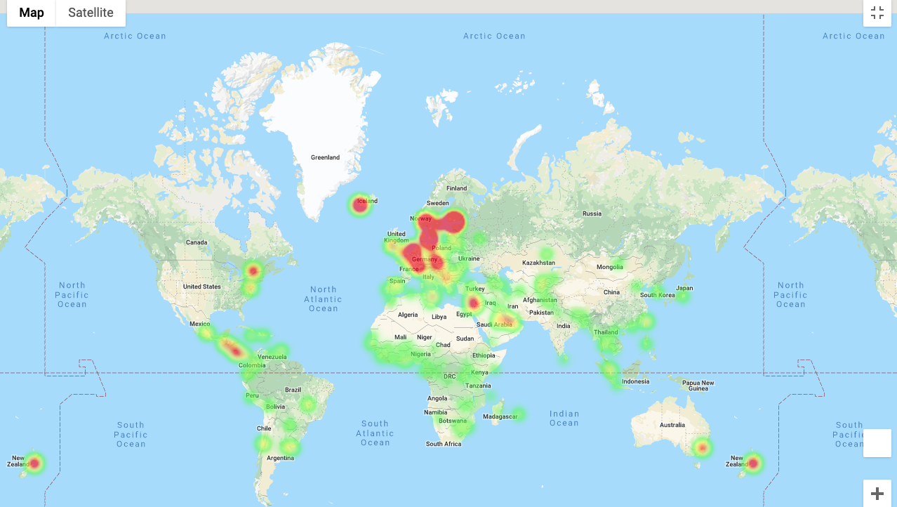
What are the ‘Happiest’ Countries?
The Lucky Ones are Finland, Denmark, Norway, Iceland, Netherlands, Switzerland, Sweden, New Zealand, Canada, Austria, Australia, Costa Rica…
Happiest Countries in the World
Data : Gallup(2019) ‘World Happiness Report’ / Google Maps API

Slide 12
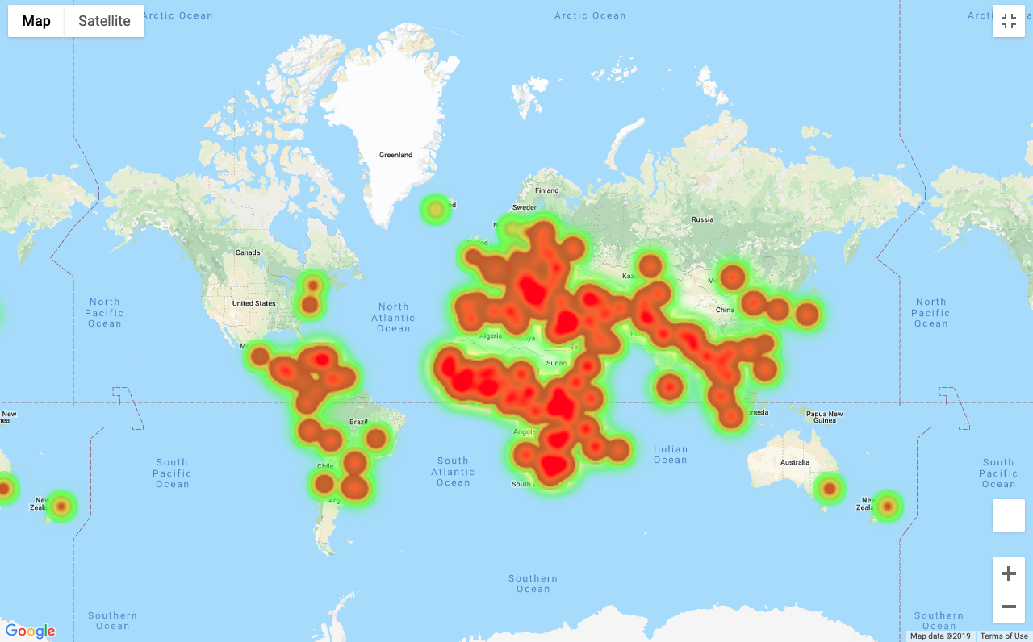
What are the most ‘Miserable’ Countries?
They are South Sudan, Central African Republic, Afghanistan, Tanzania, Rwanda,
Yemen, Malawi, Syria, Botswana, Haiti, Zimbabwe, Brunai…
Most Miserable Countries in the World
Data : Gallup(2019) ‘World Happiness Report’ / Google Maps API

Slide 13
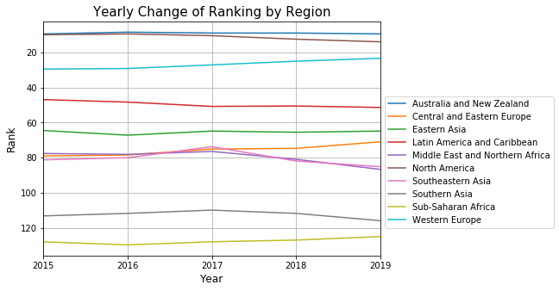
Regional Trend
But, Look at all the differences by region!
Yearly Change of Ranks by Region
Data : Gallup(2015~2019) ‘World Happiness Report’

Slide 14
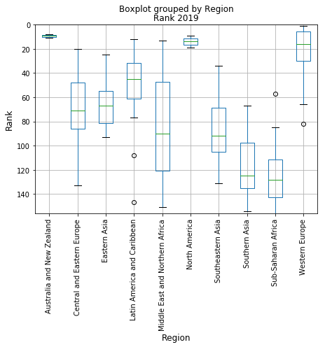
Regional Variance in 2019
Variances also differ by region!
Boxplot Grouped by Region Rank 2019
Data : Gallup(2019) ‘World Happiness Report’

Slide 15
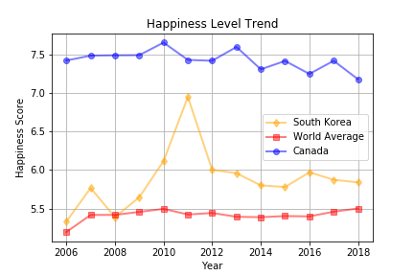
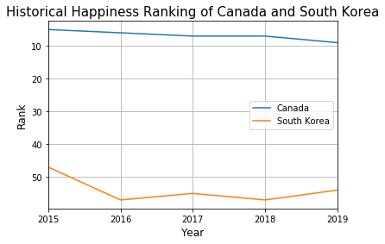
Any Specific Interest?
Want to know more about each country?
Happiness Level Trend of Canada and South Korea
Data : Gallup(2006~2018) ‘World Happiness Report’ / Gallup(2015~2019) ‘World Happiness Report’

Slide 16

II. What ‘Factors’ Correlate More
With the Level of Happiness?

Slide 17
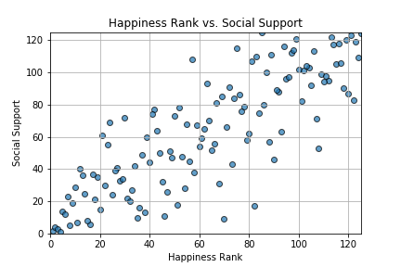
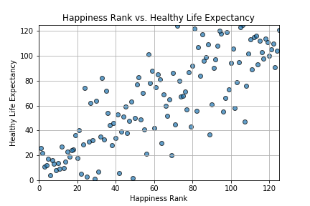
Factor Correlation Analysis
As seen below, Social Support and Life Expectancy are highly correlated with Happiness
1) Social Support
2) Healthy Life Expectancy
Data : Gallup(2019) ‘World Happiness Report’

Slide 18
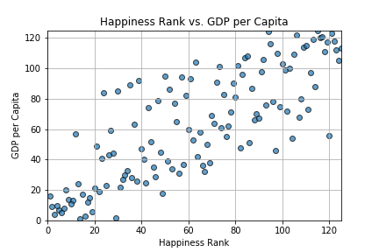
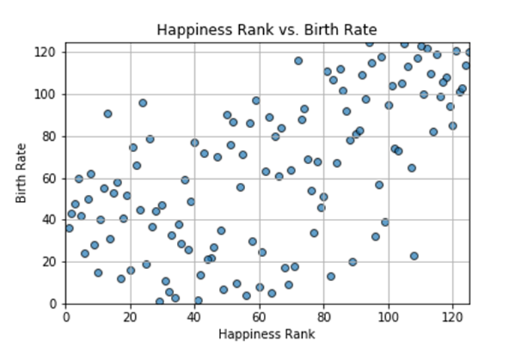
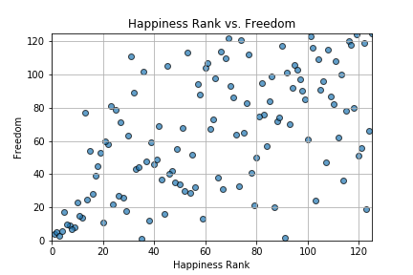
Factor Correlation Analysis
GDP, Birth Rate, and Freedom are somewhat correlated with Happiness
3) GDP per Capita
4) Birth Rate
5) Freedom
Data : Gallup(2019) ‘World Happiness Report’ / CIA(2018) ‘Birth Rate’

Slide 19
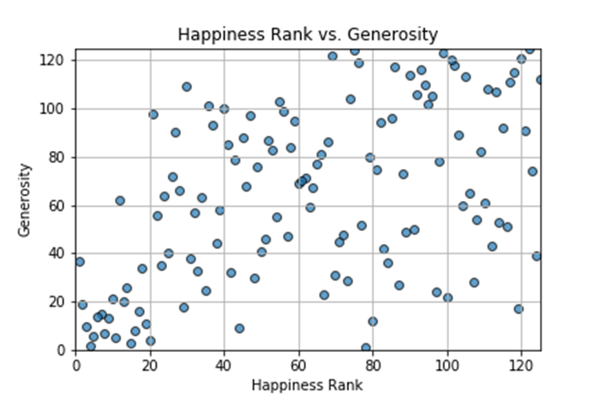
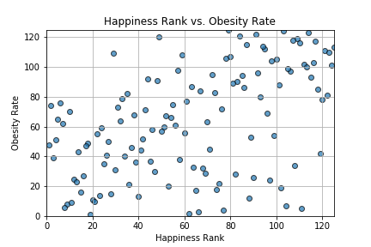
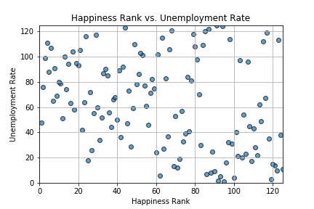
Factor Correlation Analysis
Generosity, Obesity, Unemployment are only mildly correlated with Happiness
6) Generosity
7) Obesity Rate
8) Unemployment Rate
Data : Gallup(2019) ‘World Happiness Report’ / CIA(2016) ‘Birth Rate’ / CIA(2017) ‘Unemployment’

Slide 20
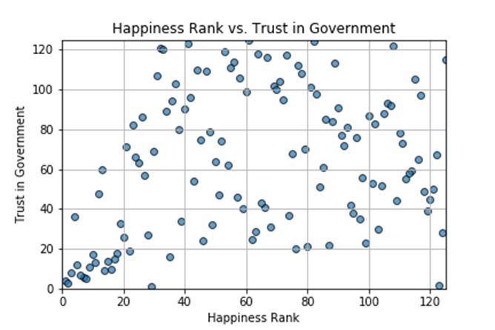
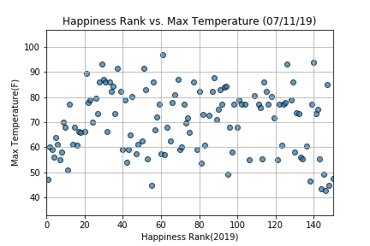
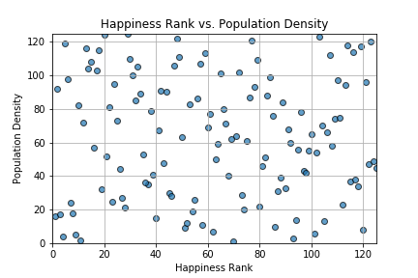
Factor Correlation Analysis
Obviously, Thanos is wrong!! Look at the Population Density!
9) Trust in Government
10) Temperature
11) Population Density
Data : Gallup(2019) ‘World Happiness Report’ / CIA(2018) ‘Population’, ‘Area’ / WorldBank API & OpenWeatherMap API for ‘’Weather’

Slide 21
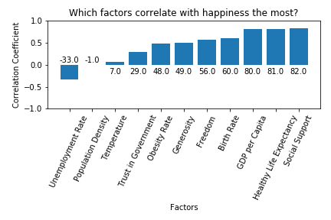
Correlation Coefficient Summary
Tada! Here come all the numbers!

Slide 22

III. Why and How are the ‘Top Two Factors’
Strongly Related to Happiness?

Slide 23
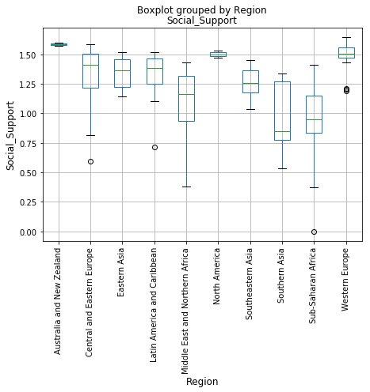
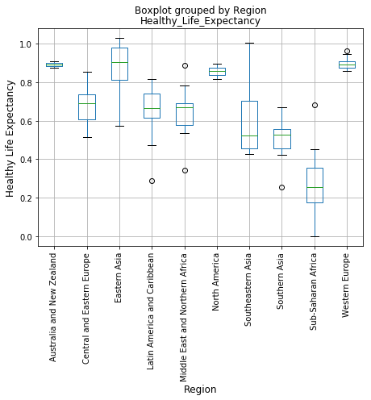
Delving into the Top Two
Just as the regional variance in happiness ranks, the top two factors show similar variances.
Social Support by Region (2018)
Life Expectancy by Region (2018)
Data : Gallup(2018) ‘World Happiness Report’

Slide 24
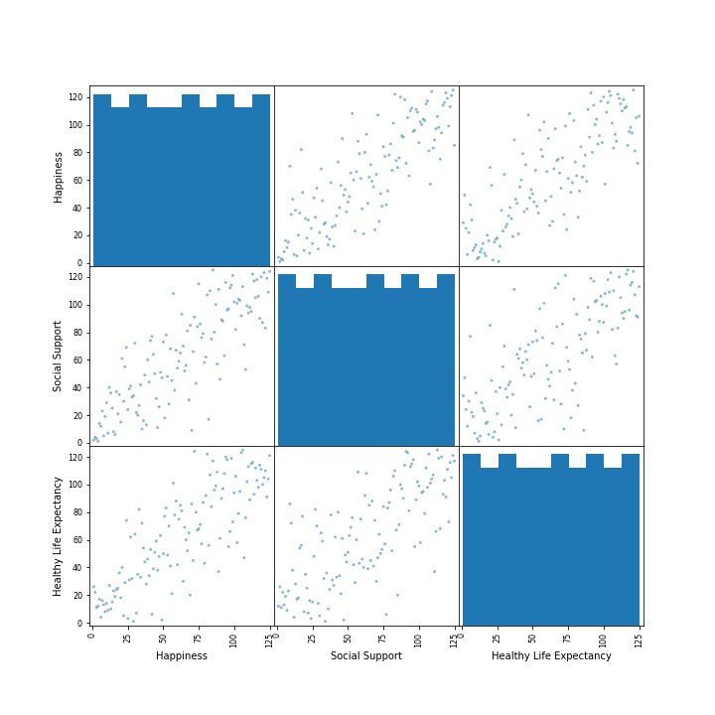
Putting Them Altogether
The top two factors and happiness itself are strongly correlated with each other!
Scatter Matrix (Happiness, Social Support, and Life Expectancy
Data : Gallup(2019) ‘World Happiness Report’

Slide 25
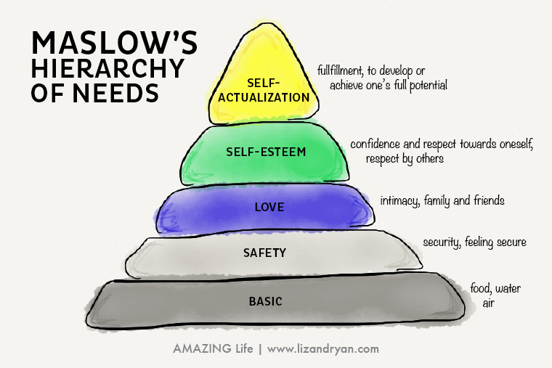
Food for thought...

Slide 26
Questions?
Thank you!

